Slide 1
3D BUILDING
Group member:
Muhammad Shazzad Hossain
id- 011 152 018
Mustafizur Rahman
id- 011 142 047

Slide 2
Introduction

Slide 3
Feature List
3d view
Animation
Control using keyboard & mouse
texturing

Slide 4
SCREEN SHOT

Slide 5
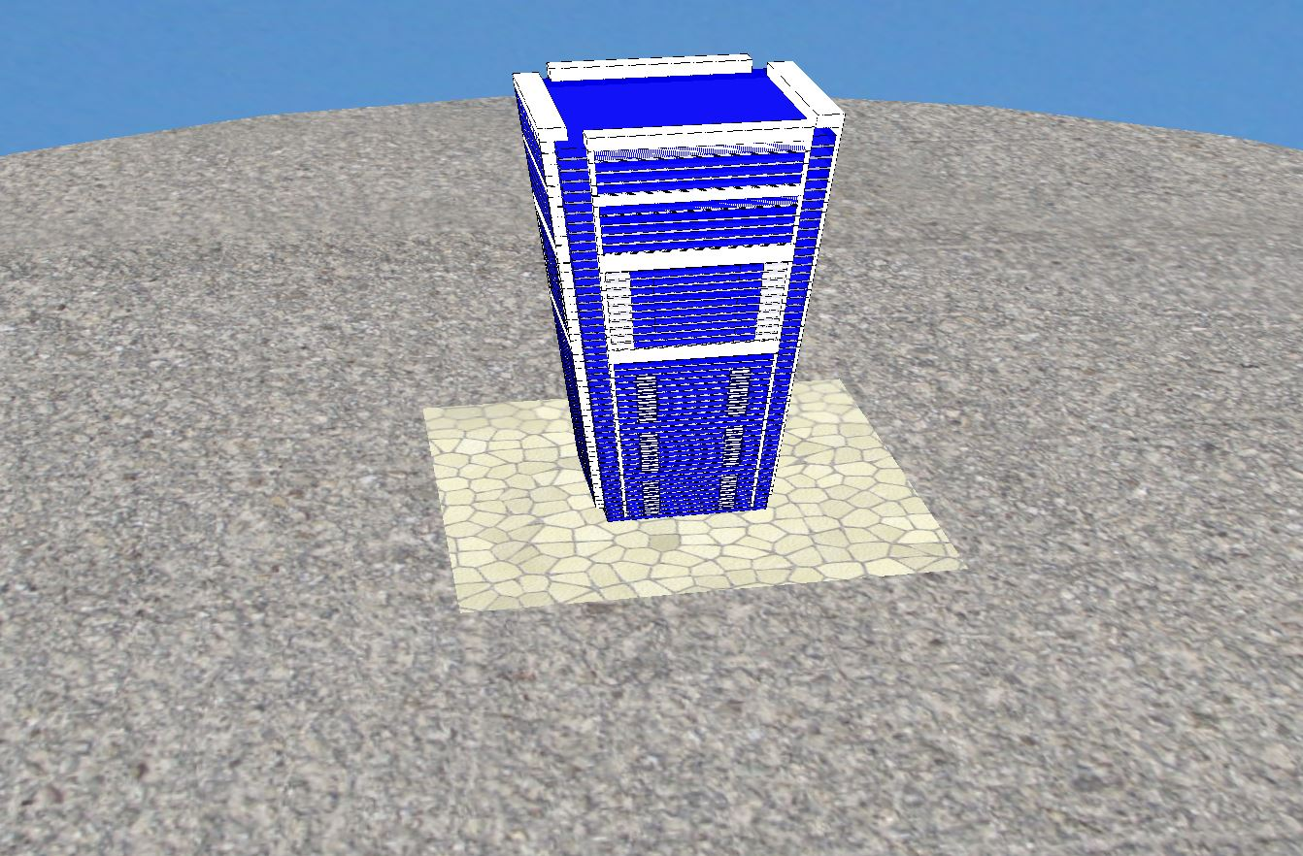

Slide 6
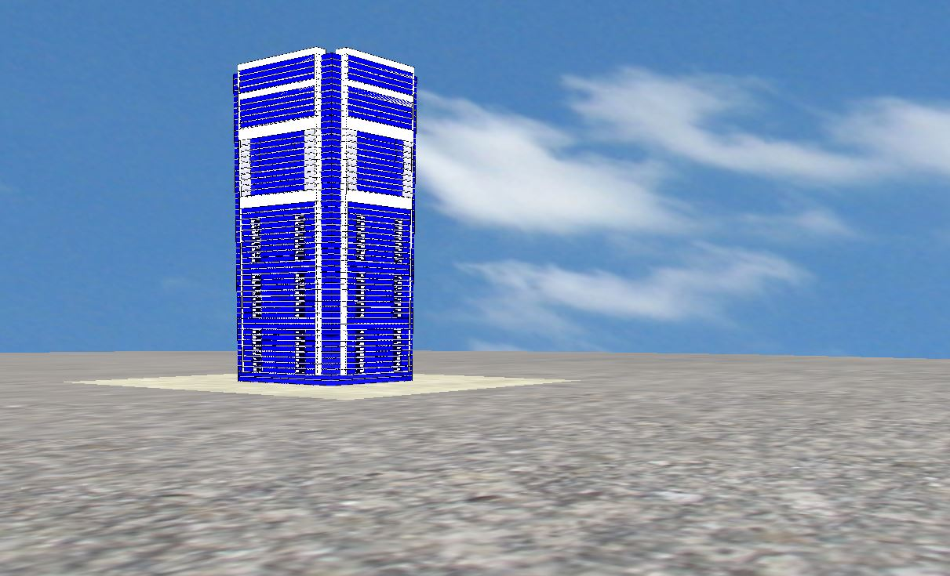

Slide 7
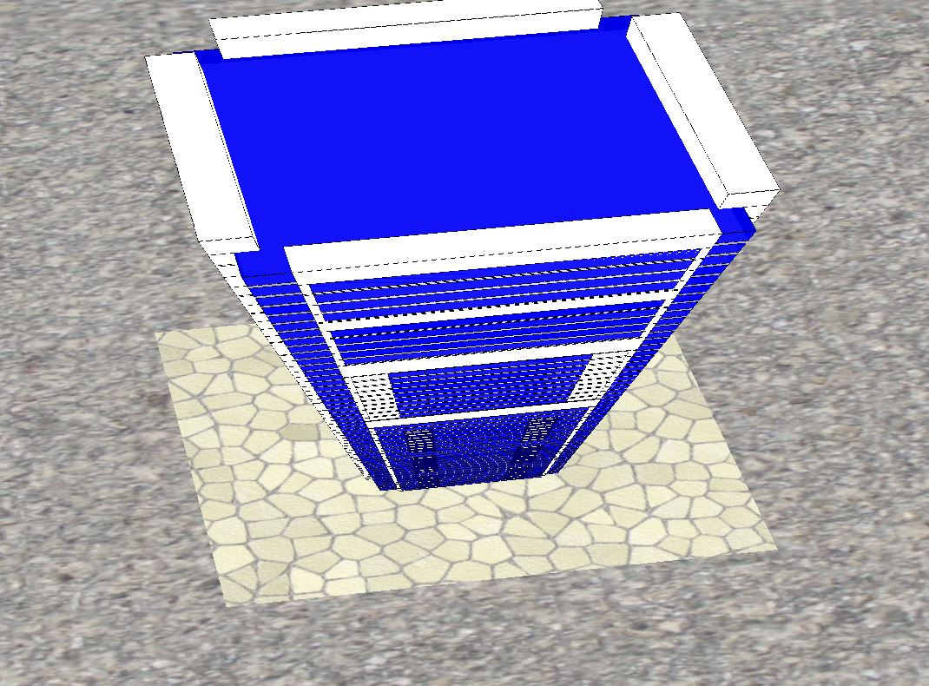

Slide 8
THANK YOU

